Slide 1
Welcome to UCD Library

Slide 2
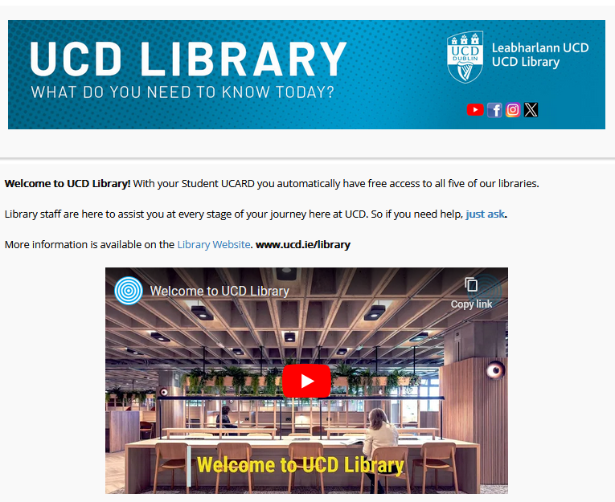
Orientation Welcome
libguides.ucd.ie/newstudents

Slide 3
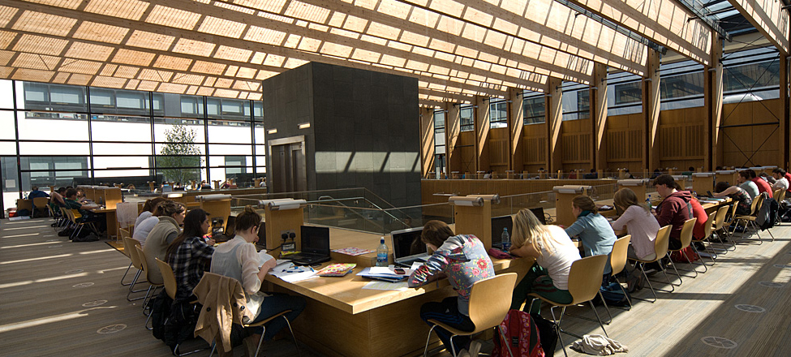
Health Sciences & James Joyce Libraries

Slide 4
New to UCD Library
Studying on campus
Studying at home
A mixture of both

Slide 5
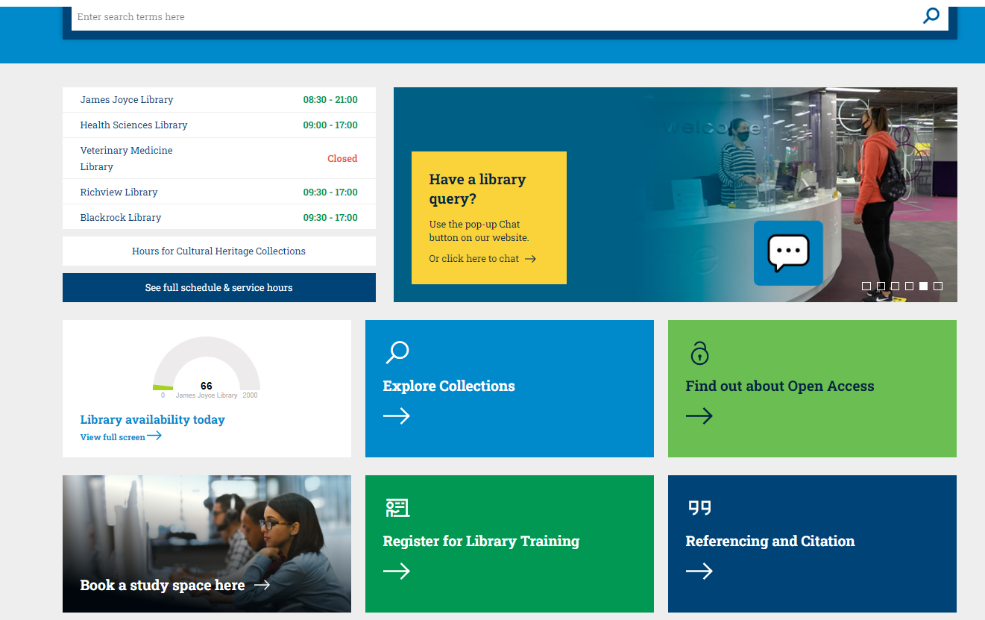
Our Library Website: ucd.ie/library
Searching
Online Tools
Rolling Information
Opening
Hours
Explore
Explore
Explore
Real-Time
Occupancy
Check
Explore
Open Access
Training
Citation
Study Seats

Slide 6
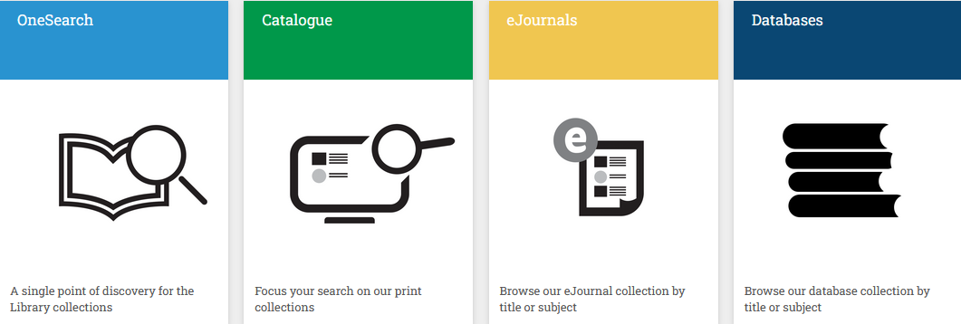
www.ucd.ie/library/onlinetools/

Slide 7
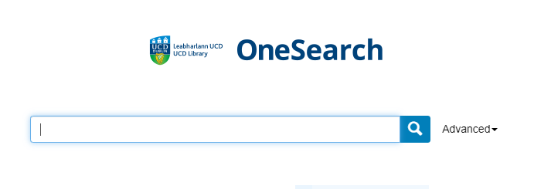

Slide 8
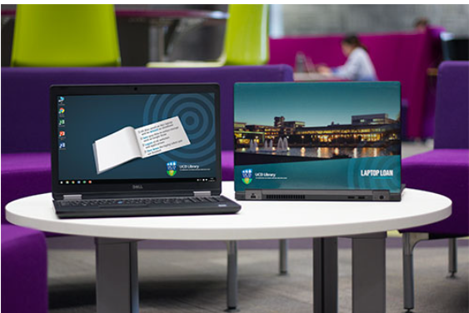
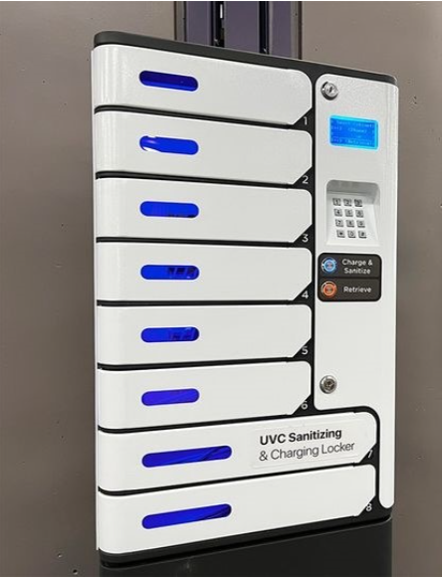
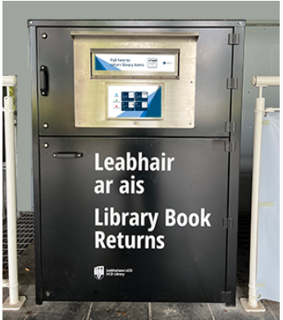
Services

Slide 9
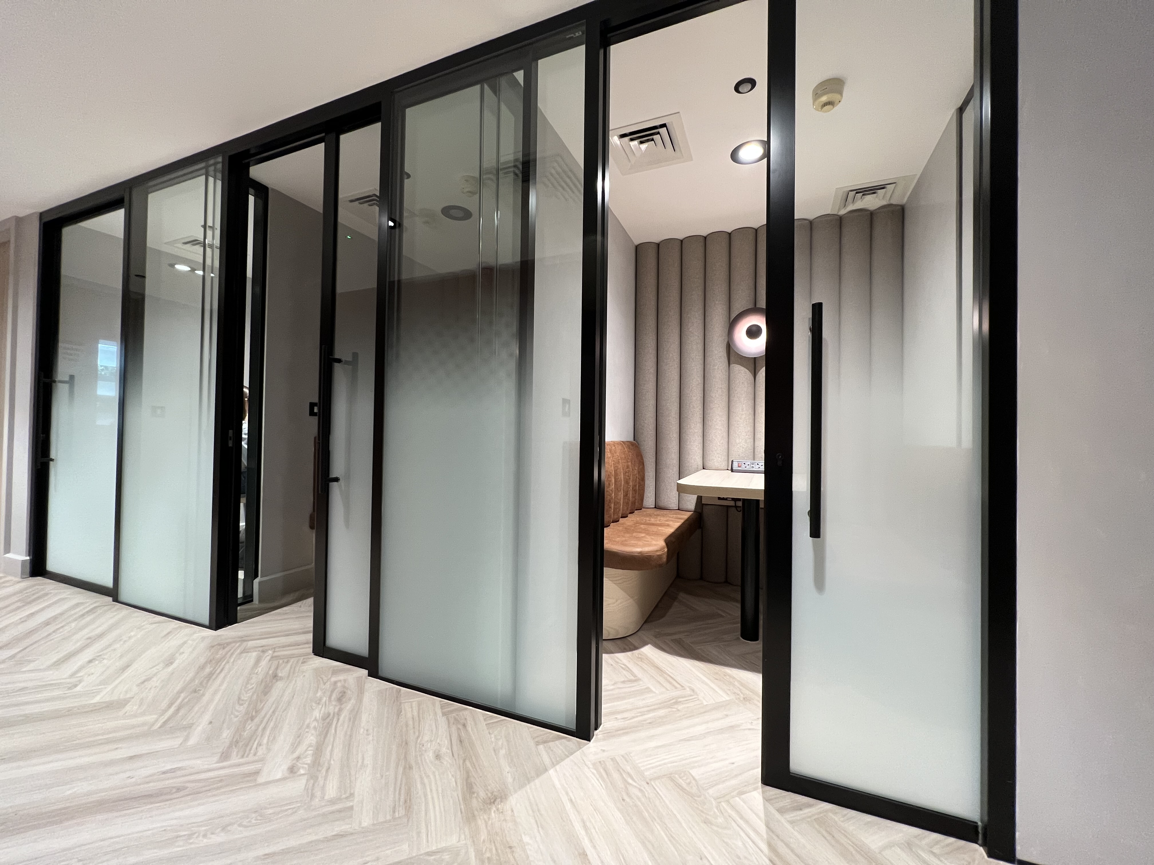
Bookable zoom rooms (JJL)
https://libcal.ucd.ie/r

Slide 10
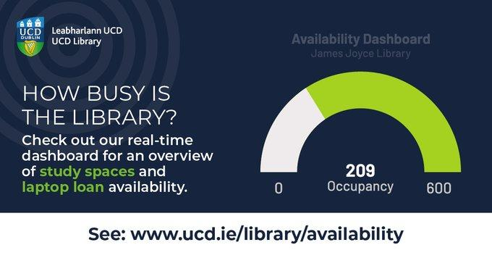

Slide 11
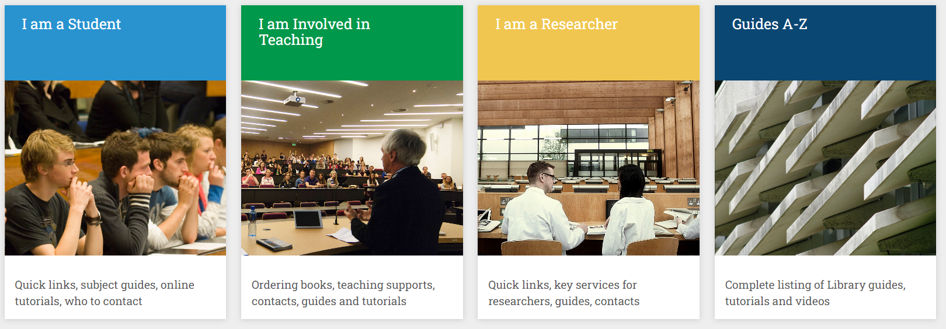
ucd.ie/library/guides/

Slide 12
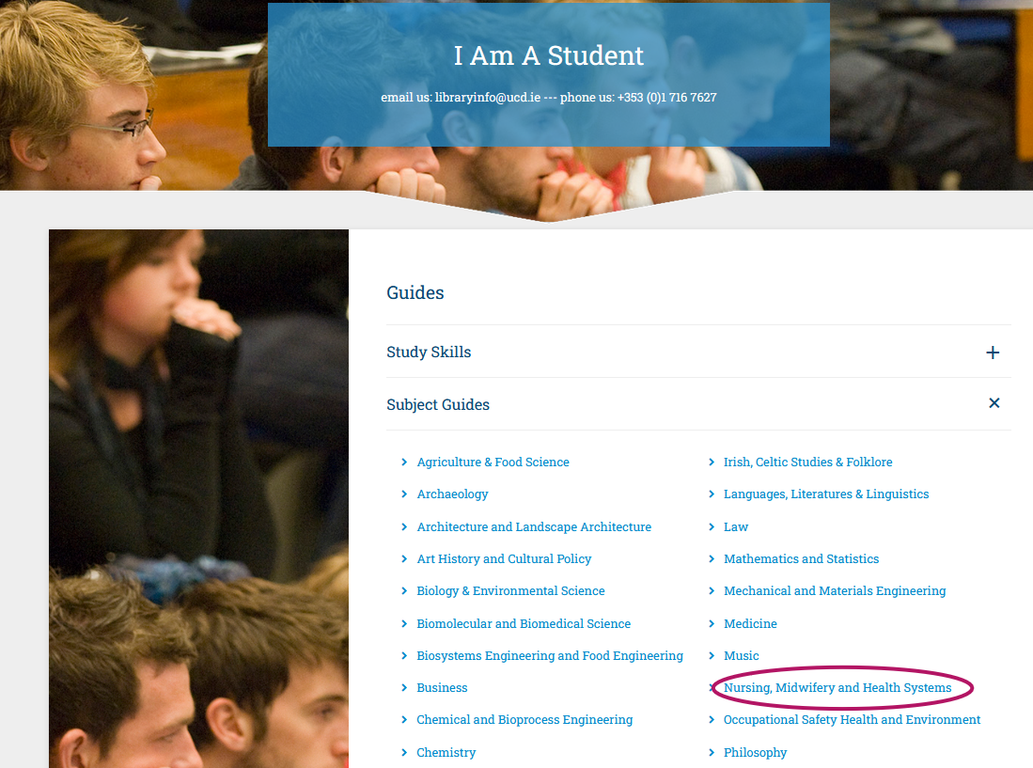

Slide 13
Support
Contact your Teaching Librarian: https://www.ucd.ie/library/contact/tll/
Use the Library Chat tool: https://www.ucd.ie/library/contact/chat/
Ask our staff at the library’s information desks.
Email us at libraryinfo@ucd.ie

Slide 14
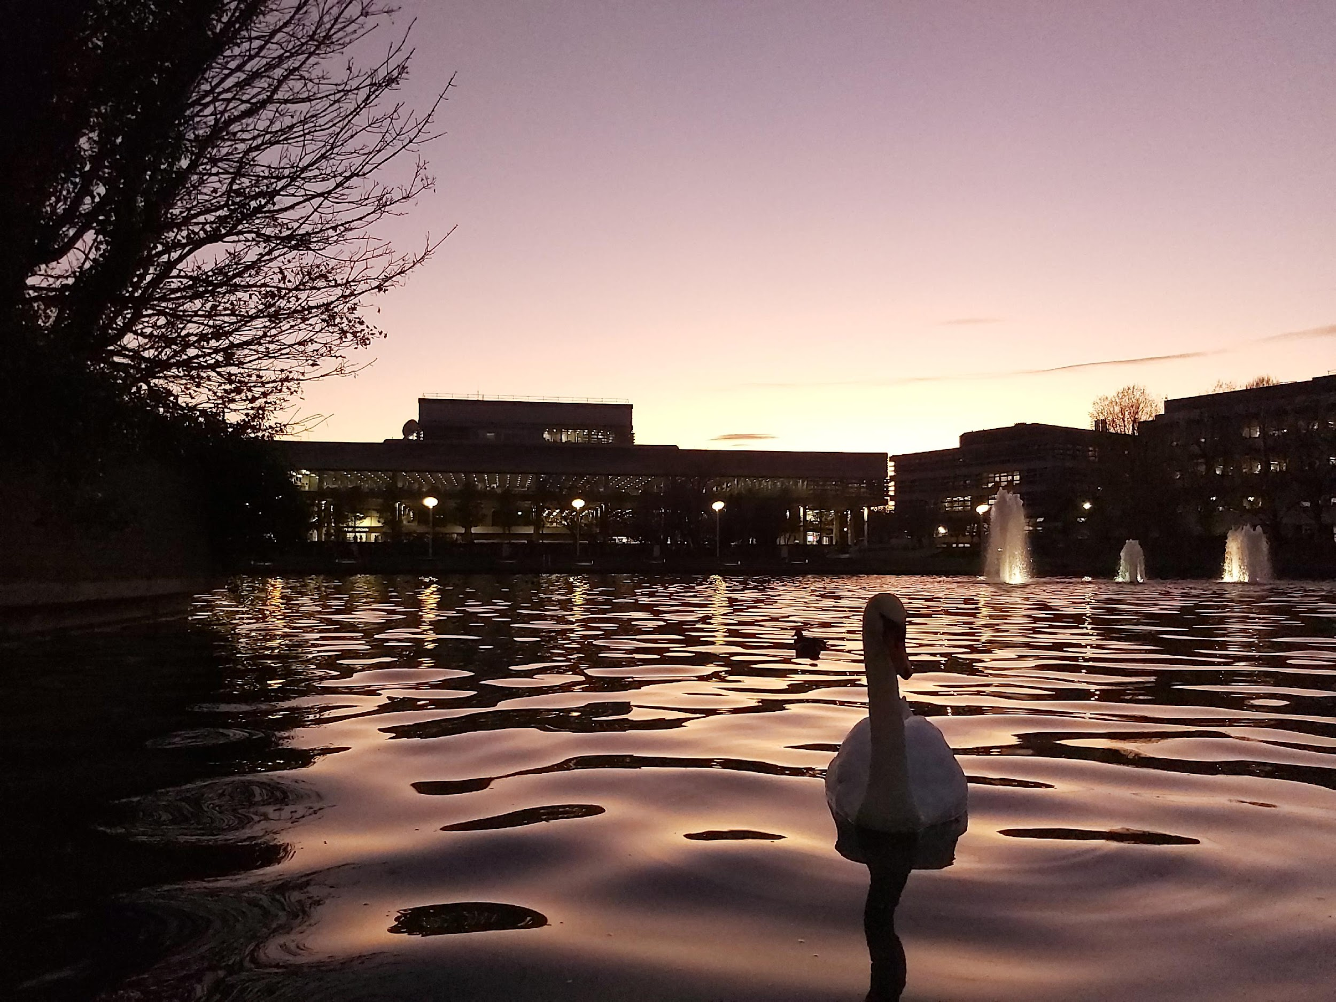
ucd.ie/library

